Slide 1
Essential Foundational Practices for Success:
Taming the Early Literacy Giant
March 10, 2023

Slide 2
Agenda
Day 3
Culminating Activity
Action Planning
Next Steps
Wrap-Up
Closing

Slide 3
Pulse Check

Slide 4
Mentimeter
Your Feedback is Important to Us!
Add Results from MentiMeter

Slide 5
Culminating Activity A-B-C Book on Equity and Early Literacy

Slide 6
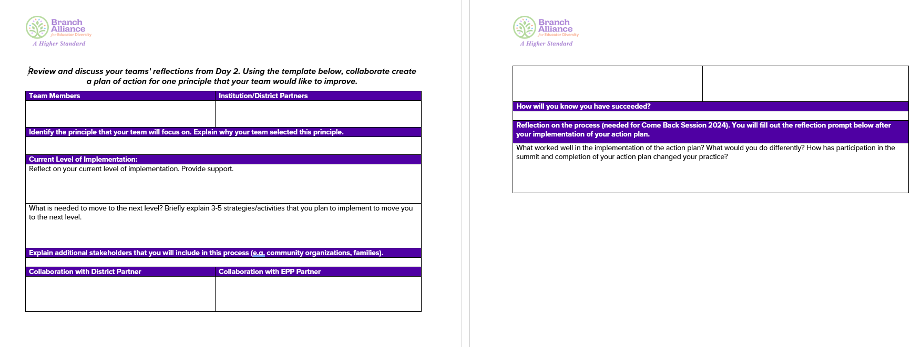
Action Plan

Slide 7
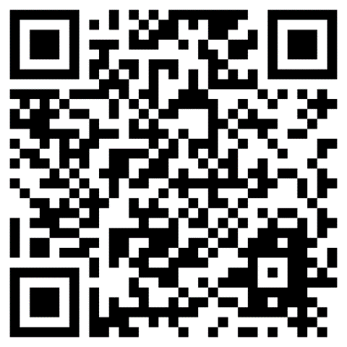
Summit Webpage
Accessing Resources

Slide 8
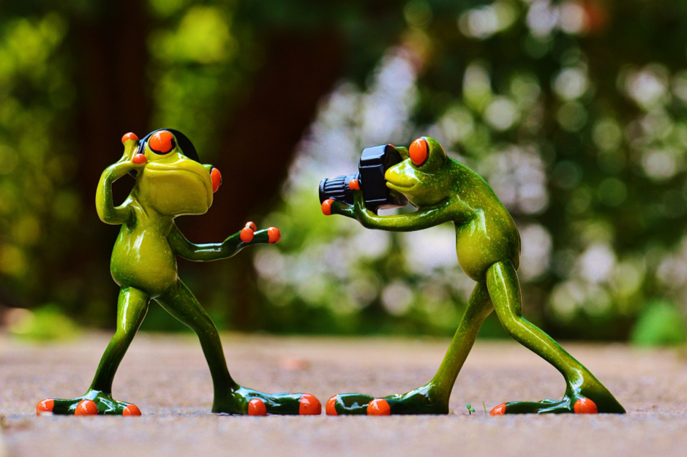
Bananagram
Take a Picture of Your Final Bananagram
Tweet it and email it to: drzimmer@educatordiversity.org

Slide 9
Next Steps
Come Back Session: Spring 2024
Submit your Action Plan
Digital Badge
Apply your Action Plan
Share your Progress at the Spring Come-back Session
2-Year Sprint

Slide 10
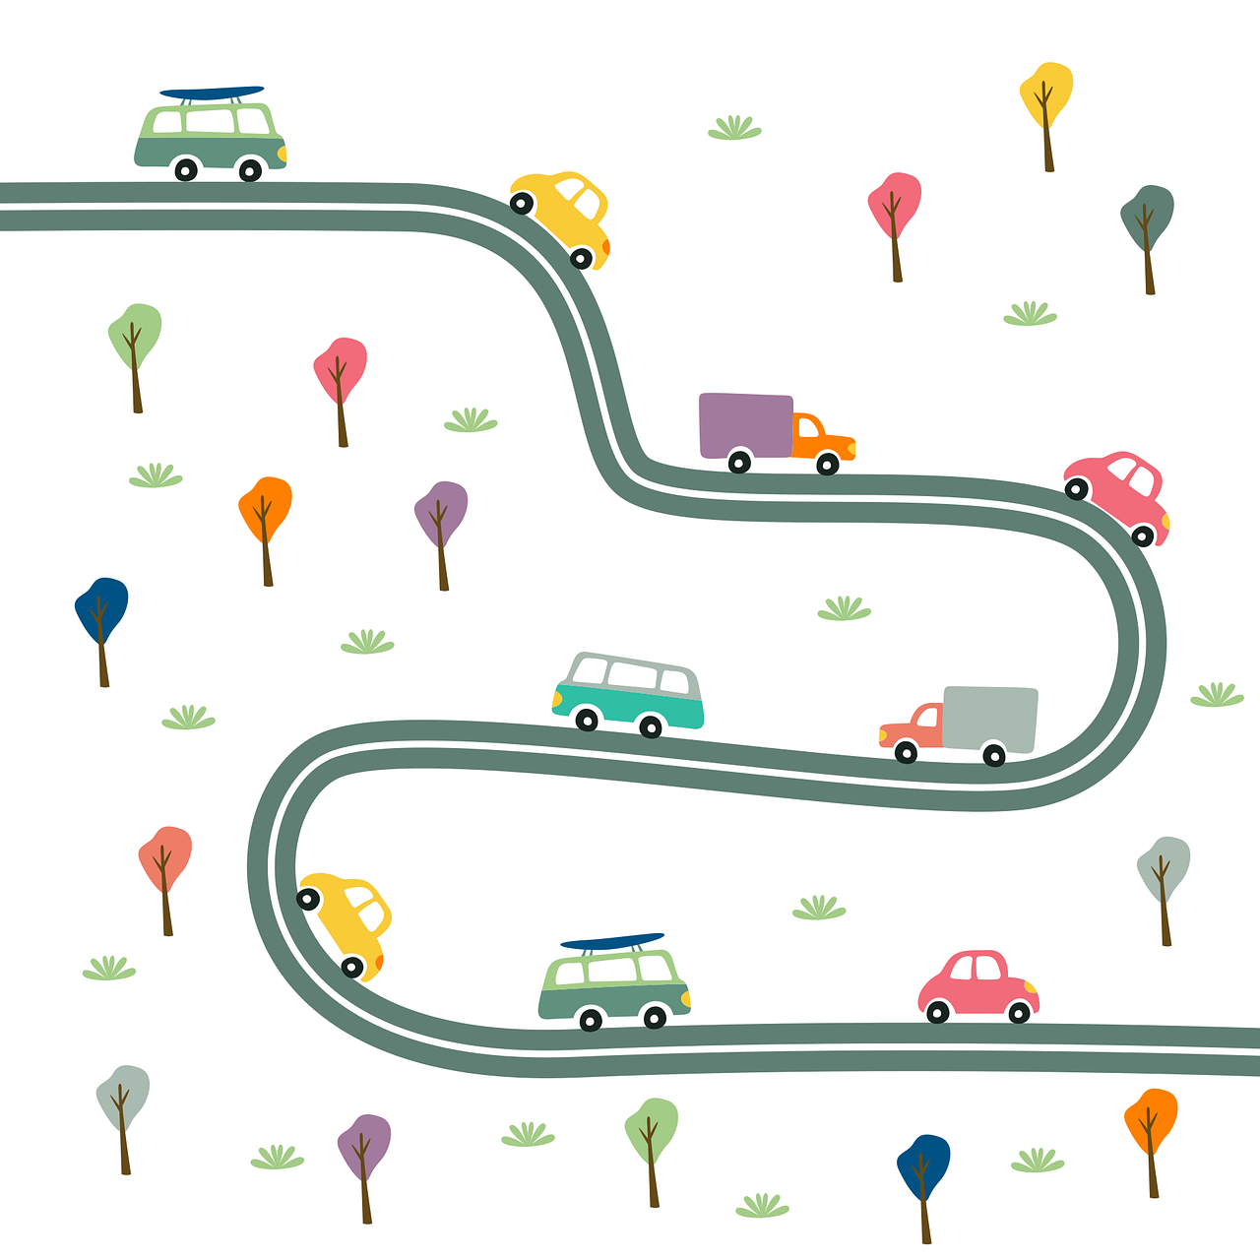
Project ELITE: Opportunity
Inaugural Cohort: 3 Institutions
2 Year Journey
Year 1: Professional Learning and Planning
Year 2: Application and Implementation
Coaching
Community of Practice

Slide 11
Upcoming Events
Please Join Us!
Date | Time | Title | Speaker
3-29-2023 | 12-2:00PM CT | Self-assessing Implicit Linguistic Biases: From Deficit-Minded Assumptions to Equity-Minded Beliefs in Teaching & Learning | Dr. Alyssa Cavazos
4-5-2023 | 12-1:00 PM CT | Ready Day 1: The Intersection of Content, Pedagogy, and the Learner | Dr. Jerrell Hill
4-19-2023 | 12-2:00 PM CT | Centering Art to Question the World Around Us | Dr. Christian Faltis
4-25/26-2023 | 12-2:00 PM CT | Innovative Solutions: Using Mixed Reality Simulation in the Classroom | Dr. Freda Hicks, Dr. Christian Bracho, and Dr. Nathan Blom
5-3-2023 | 12-1:00 PM CT | The BranchED Framework in Action! | Dr. Patty Alvarez McHatton, Dr. Kate Zimmer, Dr. Sanjuana Rodriguez

Slide 12
Upcoming Events: Data Focused
Please Join Us!
Date | Time | Title | Speaker
4-4-2023 | 12-2:00PM CT | The Data is in the Details Workshop Series: Practice Makes Progress | Dr. Alicia Quiroz
5-4-2023 | 12-2:00 PM CT | The Data is in the Details Workshop Series: Closing the Loop Using Survey Data | Dr. Alicia Quiroz
6-7/9-2023 |  | The Data Roadmap: Plotting Your Journey to Data Empowerment* | BranchED
* Currently accepting applications for 3-person teams. We can sponsor 10 institutions.

Slide 13
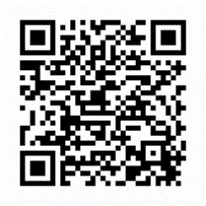
Evaluation
Your Feedback is Important to Us!!
https://survey.alchemer.com/s3/7245807/2023-03-Spring-Summit-Reflection

Slide 14
BranchED Circle Talk
Speaking from the Heart; Listening With Respect
The Significance of Circles
Circles are symbolic in many cultures and contexts
Circles represent equality, interconnectedness, and continuity
Circle Talk is built on the belief that every human being wants to be connected to others in a good way
Circles build community

Slide 15
Reflection and Anticipation

Slide 16
Don’t Forget
Grab your Box Lunch
Safe Travels!!

Slide 17
Thank you for your time!
info@educatordiversity.org
(800) 519-0249
www.educatordiversity.org

