Slide 1
Essential Foundational Practices for Success:
Taming the Early Literacy Giant
March 8, 2023

Slide 2
Welcome

Slide 3
Agenda
Day 1
Welcome and Introduction to BranchED
Connector
Initial Program Reflection
BranchED Framework for Quality Educator Preparation
Quality Early Literacy Educator Preparation
Closing

Slide 4
Our Vision
Highly Effective Diverse Educators for all Learners
Branch Alliance for Educator Diversity (BranchED) strengthens, grows, and amplifies the impact of educator preparation programs at minority serving institutions, with the broader goals of both diversifying the teaching profession and intentionally championing educational equity for all students.​

Slide 5
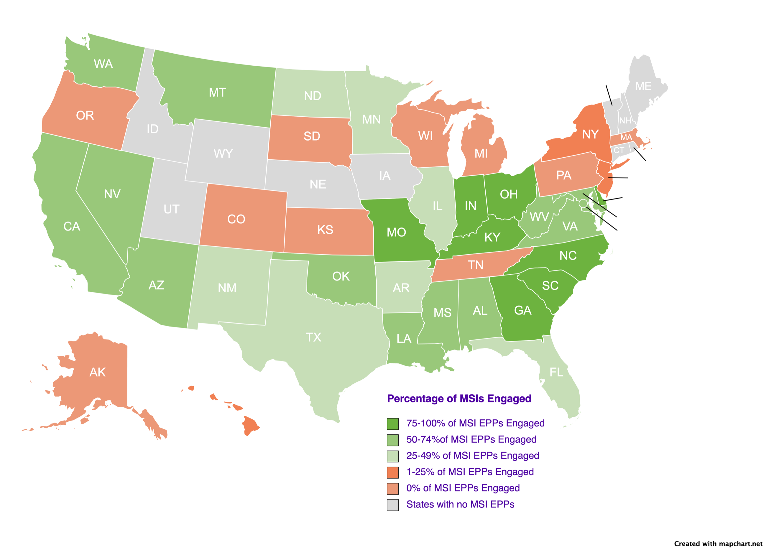
BranchED
By the Numbers
38 states and territories
820 faculty and leaders
204 EPPs that:
Prepare 78,000 teacher
candidates annually
Graduate 24,823 candidates per
year
Female

Slide 6
How We Do It
Educational Equity Accelerator
PK-12 and the Education Sector
Transformation Center
Institutions
Innovation and Inquiry
Collaboratives
BranchED Inclusive Rigorous Content Hub
Individuals

Slide 7
Early Literacy
Literacy is the foundation of all learning.
It is more than just reading.
Social success is linked to literacy.
Early literacy is linked to later school success.
Ali, A. (2022)

Slide 8
STATS
Importance of Literacy Education
Children of adults with low literacy skills are 72% more likely to be at a low reading level in school
Two out of every 10 children enter kindergarten with skills two to three years lower than their grade level, and another two start school with a one-year disadvantage
Some 65% of students are below basic reading level or below proficient reading level in the fourth grade
The Department of Justice states, “The link between academic failure and delinquency, violence, and crime is welded to reading failure. Over 70% of inmates in America’s prisons cannot read above a fourth-grade level.
ProLiteracy, Children’s Reading Foundation, NCES, Governor’s Foundation

Slide 9
What We Can Do
By the age of 2, children who are read to regularly display greater language comprehension, larger vocabularies, and higher cognitive skills than their peers.
The most successful way to improve the reading achievement of low-income children is to increase their access to print.
Book giveaway programs promote children’s home literacy environment which results in more interest in reading and higher reading scores during early education.
(Raikes et al., 2006; Newman, et al., 2020; de Bondt, et al., 2020)
Notes:
Raikes, H., Pan, B.A., Luze, G.J., Tamis-LeMonda, C.S.,Brooks-Gunn, J., Constantine, J., Tarullo, L.B., Raikes, H.A., & Rodriguez, E. (2006). Mother-child bookreading in low-income families: Correlates and outcomes during the first three years of life. Child Development, 77(4).
Newman, S., Brazelton, T. B., Zigler, E., Sherman, L. W., Bratton, W., Sanders, J., & Christeson, W. (2000). America’s Child Care Crisis: A Crime Prevention Tragedy. U.S. Department of Education, ERIC, Washington, DC.
de Bondt, M., Willenberg, I. A., & Bus, A. G. (2020). Do book giveaway programs promote the home literacy environment and children’s literacy-related behavior and skills? Review of Educational Research, 90(3), 349-375.

Slide 10
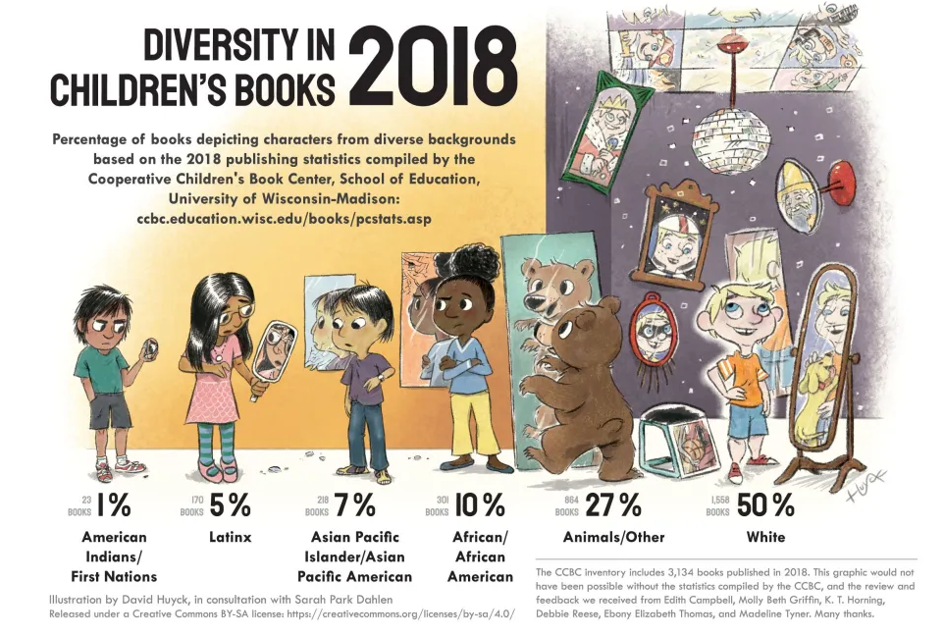
Representation in Children’s Books

Slide 11
Project ELITE: Opportunity
Inaugural Cohort: 3 Institutions
2 Year Journey
Year 1: Professional Learning and Planning
Year 2: Application and Implementation
Coaching
Community of Practice

Slide 12
Introductions: JAG Members
Nancy Valdez-Gainer
Cindy Collado
Kellee Watkins
Betty Coneway
Anthony Broughton
Sanjuana Rodriguez

Slide 13
Goals
Learn From Our Peers
Network
Enhance Our Toolkit
Have Fun
icons created by Freepik - Flaticon</a>

Slide 14
Learning Objectives
Add to participants’ knowledge base and share available resources to support EPP implementation of evidence-based practices
1
Explore opportunities and influences that will allow pre-service teachers to extend their early literacy content knowledge throughout their teacher education programs
2
Apply the BranchED’s asset mapping diagnostic tool for use in assessing curriculum, field experiences, and faculty capacity to implement early literacy evidence-based practices
3
Create an action plan to revise or enhance current practices as informed by summit learnings
4

Slide 15
Digital Badge
Indicator of accomplishment that can be shared with your networks ​
Aligned to specific competencies ​
Requires completion of a deliverable

Slide 16
Share Your Learning
Internally and Externally
The Experience​
The Learning​
The Networking​
The Fun​
​
#BranchEDSpring2023Summit​
#BranchEDStorytime
Notes:
Need the twitter hashtags

Slide 17
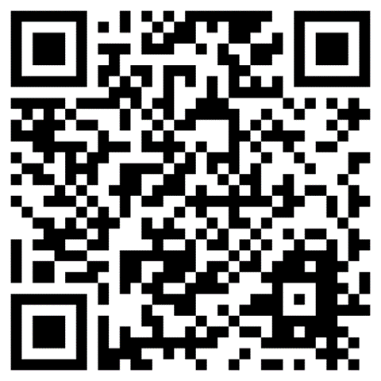
Summit Webpage
Accessing Resources

Slide 18
BranchED Story Time

Slide 19
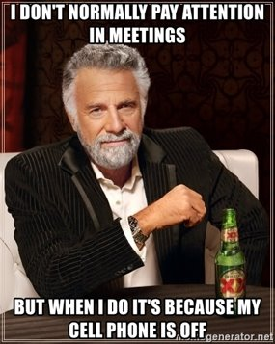
Norms
Take an Inquiry Stance​
Be Vulnerable
Assume Positive Intentions​
Take Responsibility for Impact ​
Value Multiple Perspectives ​
Be Present and Present

Slide 20
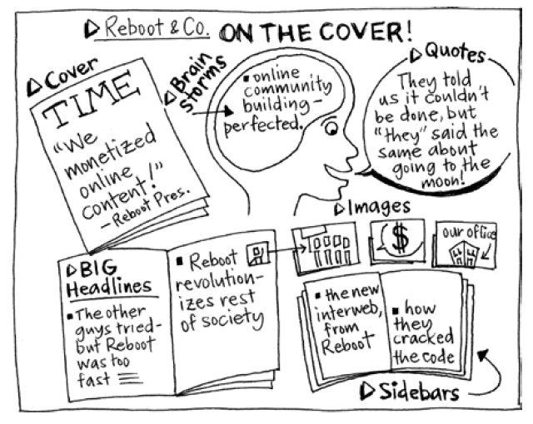
CONNECTOR
COVER STORY
https://gamestorming.com/cover-story/
Notes:
Cover Story is a game about pure imagination. The purpose is to think expansively around an ideal future state for the organization; it’s an exercise in visioning. The object of the game is to suspend all disbelief and envision a future state that is so stellar that it landed your organization on the cover of a well-known magazine. The players must pretend as though this future has already taken place and has been reported by the mainstream media. This game is worth playing because it not only encourages people to “think big,” but also actually plants the seeds for a future that perhaps wasn’t possible before the game was played.

Slide 21
Objective
Individually: Imagine best-case scenario for your institution and District Partner
Group: Share your imaginings. Generate your collective Story of The Year. Represent the story on the template.
Share Out
Teams introduce their members and share one aspect of the Cover Story
Process
Exercise in Visioning:
Think expansively around a future state of your early literacy program/offerings.
Consider how EPP-District Partners are working together to bring this reality to fruition.
Notes:
The object of the game is to suspend all disbelief and envision a future state that is so stellar that it landed your organization on the cover of a well-known magazine. The players must pretend as though this future has already taken place and has been reported by the mainstream media. This game is worth playing because it not only encourages people to “think big,” but also actually plants the seeds for a future that perhaps wasn’t possible before the game was played.

Slide 22
CATEGORIES
Definitions
Cover
tells the BIG story of their success.
Headlines
convey the substance of the cover story.
Sidebars
reveal interesting facets of the cover story.
Quotes
can be from anyone as long as they’re related to the story.
Brainstorm
is for documenting initial ideas for the cover story.
Images
are for supporting the content with illustrations.

Slide 23
Share Out

Slide 24
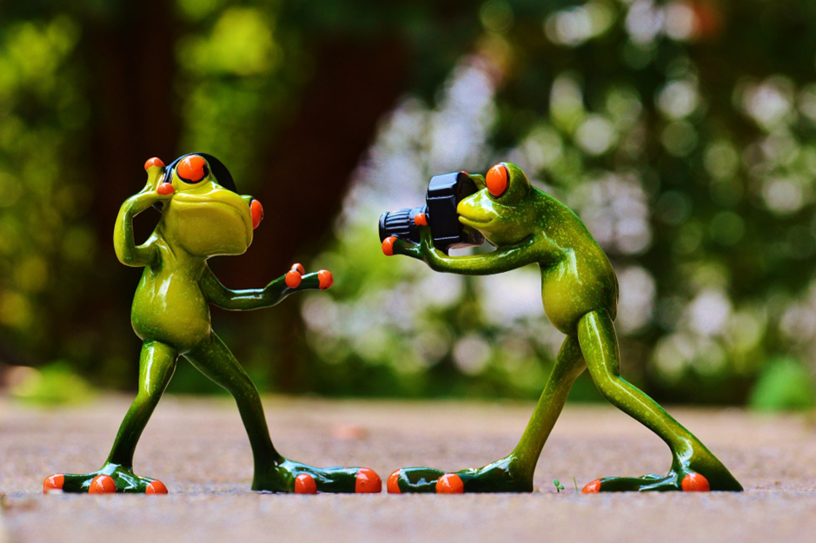
Bananagram
Based on your cover story, create one word or a phrase that reflects where you aspire to be with regard to early literacy.
Take a Picture of Your Bananagram
Tweet it and email it to: drzimmer@educatordiversity.org

Slide 25
BRANCHED's BANANAGRAM

Slide 26
Break Time!

Slide 27
EARLY LITERACY IN YOUR PROGRAM

Slide 28
Current State: Early Literacy, Teacher Development
Content
Clinical Experiences
Induction
Progression
Partnerships

Slide 29
PERSONAS
Jane
Paraprofessional
Sophia
High School Student
Darius
First Year Teacher

Slide 30
Brief Bios
Jane
Sophia
Darius
Jane is a paraprofessional in the early childhood program at your partner District. She has an Associates Degree from 10 years ago and wants to become a teacher.
Sophia is an 18-year-old recent high school graduate. She has dreamed of being a teacher since she was a little girl and is excited to begin her journey.
Darius is a first-year teacher who is a career changer. He is working at a high-need school that is under pressure to improve student performance. He is the primary breadwinner for his family.

Slide 31
Quick Share Out

Slide 32
BranchED Framework for the Quality Preparation of Educators

Slide 33
Principles: Critical Shifts
Data Empowerment
Inclusive Instruction
Intersectional Content
Assessment Focused to Inquiry Driven
Teacher-Centered to Learner-Centered
Information Transmitting to Knowledge Building
Community of Learners
Equitable Experiences
Practice-Based Approach
Handshake to Huddle
Isolated to Holistic
Task Oriented to Mastery Learning

Slide 34
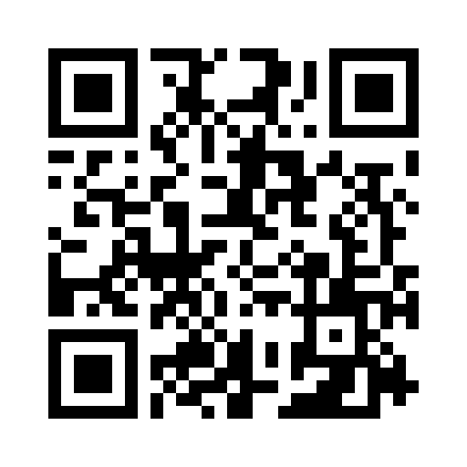
Access the Design Principle Briefs Through Our Resource Portal
Search Text: Framework

Slide 35
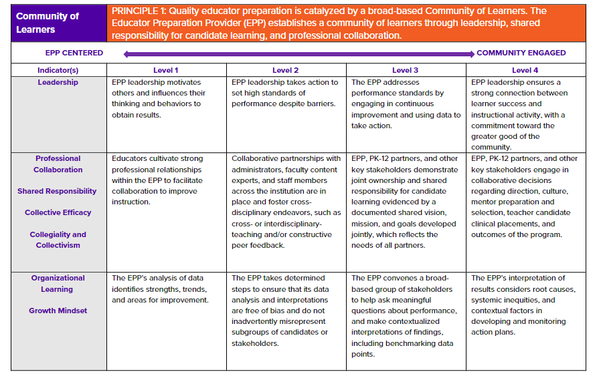
EPP Level Diagnostic Tool
Access via the Summit Web Page
INSERT QR CODE

Slide 36
How Does It Apply
High-Quality, Equity Focused Early Literacy Educators
Identify indicators of a high-quality, equity focused early literacy program
Align each to the corresponding framework principle(s)
Data Empowerment | Community of Learners | Equitable Experiences
Inclusive Instruction | Intersectional Content | Practice-Based Approach
TCs learn about formal and informal assessments
TCs differentiate instruction based on student needs
TCs fluent in the Science of Reading
TCs have opportunities to engage in clinical experiences in varied and diverse settings

Slide 37
Share Out

Slide 38
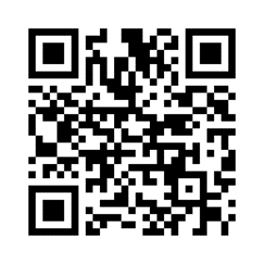
Pulse Check
https://www.menti.com/aldp1dr2hapi
Notes:
https://www.mentimeter.com/app/presentation/al7no99c1d9wymenuaovbbf2t4jgjwta

Slide 39
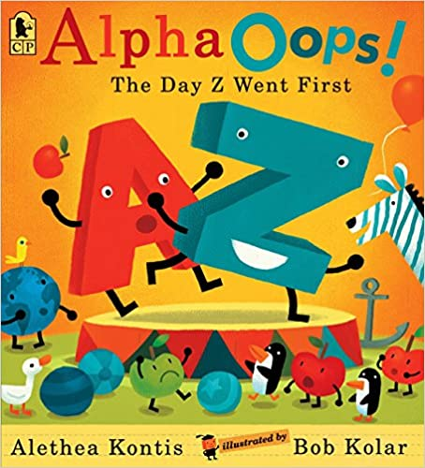
Culminating Activity A-B-C Book on Equity and Literacy

Slide 40
Creating you Team Equity and Literacy ABC Book
You will be creating the ABCS of Equity and Early Literacy. The goal is for you to create an alphabet book that exemplifies equity and literacy
Use the planning guide to determine what words you will use in your alphabet book.
Determine the format for your alphabet book (We have ABC books that you can look at to use as mentor texts).
Decide what product you will create (use paper/markers, PPT, Canva).
Work with your team to create the product.
Your team will have time to work on this culminating project throughout the summit.
Your team will present the final product on Day 3.

Slide 41
Equity and Literacy A-B-C Book Planning Template

Slide 42
Reception and Dinner

