Slide 1
Mirror, Mirror: Critical Reflection for Equity-Oriented Practice
Come-back Session
March 8-9, 2023

Slide 2
Welcome Back!

Slide 3
Agenda
Day 1
Welcome and Re-Connecting
Quick Review
Gallery Walk
Topic Discussions

Slide 4
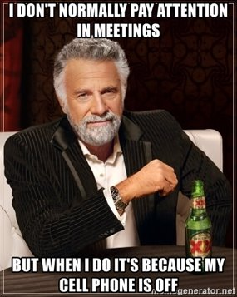
NORMS
Take an Inquiry Stance​
Assume Positive Intentions​
Take Responsibility for Impact ​
Value Multiple Perspectives ​
Be Present and Present

Slide 5
Share Your Learning
Hashtags to Share
The Experience​
The Learning​
The Networking​
The Fun​
#BranchEDSpring2023Summit
#BranchEDSummitComeback

Slide 6
RE-CONNECTING
THREE QUESTION MINGLE

Slide 7
QUICK REVIEW
VIGNETTES
INCLUSIVE INSTRUCTION RUBRIC
CRITICAL REFLECTION
EQUITY CONSCIOUSNESS AND EQUITY LITERACY

Slide 8
ACTION PLAN
Digital Badges
32 Participants
24 Digital Badges Awarded
13 Proposals Submitted for Come-back Session

Slide 9
Focus Areas
Equity Literacy and Critical Reflection
Vignettes
Vignettes with MRS
Inclusive Instruction Rubric

Slide 10
POSTER SESSION
Learning from Each Other
This Photo by Unknown Author is licensed under CC BY-SA

Slide 11
FEEDBACK CAROUSEL
INDIVIDUAL ACTION PLANS
FEEDBACK
Clarifying Questions | Probing Questions
Recommendations | Resources
Purpose
To get a variety of feedback from many people in a relatively short period of time
Set-Up
Each presenter mounts their poster on the wall along with feedback chart paper
Teams will rotate through all projects leaving behind feedback in the appropriate quadrants

Slide 12
Focus Area Discussions
COLLECTIVELY
Group discussion on implementation of action plans
What?
So What?
Now What?

Slide 13
PECHAKUCHA
Tell your collective story using images
20 slides X 20 seconds of commentary per slide = 6 minute and 40 second presentation
Slides change automatically
Speech is synchronized with the images
Notes:
Need to randomly assign presentation sequence for all participants

Slide 14
HOW-TO
Consider the topic
Gather the pictures
Develop the script
See handout for how to use PPT for your presentation
Practice
Notes:
This is on a handout

Slide 15
Come-Back Session Webpage
Accessing Resources

Slide 16
TEAM TIME

Slide 17
SHARE OUT
QUESTIONS
COMMENTS

Slide 18
Pulse Check
https://www.menti.com/alwtf4k6tg2i

Slide 19
Housekeeping
Tomorrow…
Group Picture
Pecha Kucha Time!

Slide 20
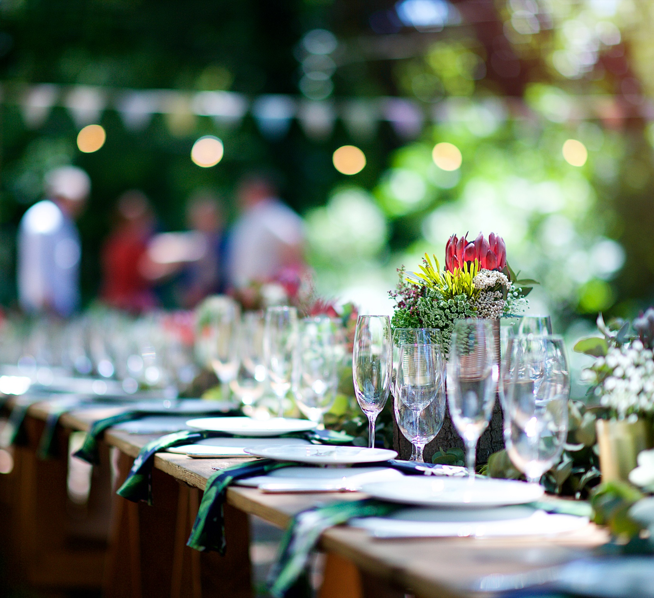
Poster Session, Reception and Dinner

